Slide 1
Network : Internetworking
Jae Hyeon Kim

Slide 2
Reference
William Stalling, Data and Computer Communications 10/E, Prentice Hall

Slide 3
Routing
Key design issue for (packet) switched networks
Many connections will need paths more than one switch
Select route across network between end nodes
Characteristics required
Correctness
Simplicity
Robustness
Stability
Fairness
Optimality
Efficiency

Slide 4
Performance Criteria
Used for selection of route
Approach for the optimum route
Simplest is choose minimum hop (least number of nodes)
Can be generalized as “least one” routing because it is more flexible, therefore it is more common than “minimum hop”
Least-cost algorithms

Slide 5
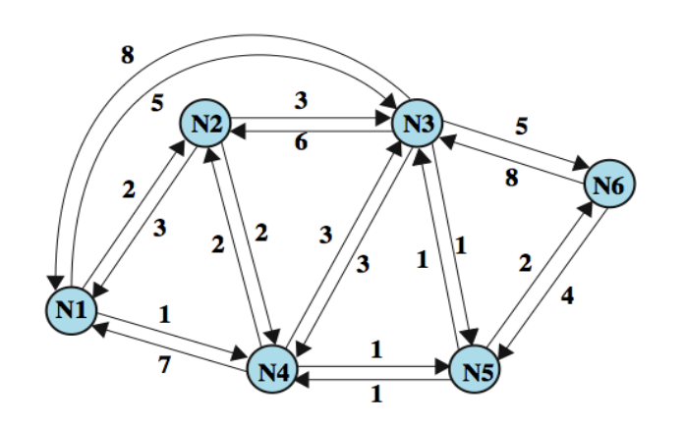
Example Packet Switched Network

Slide 6
Decision Time and Place
Time
Packet or virtual circuit basis
Fixed or dynamically changing
Place
Distributed routing : made by each node
More complex, but more robust
Centralized routing : made by some designated node
Network control center
Source routing : made by source station
Allows the user to dictate a route

Slide 7
Network Information Source and Update Timing
Routing decisions usually based on knowledge of network traffic load and link cost
Distribute routing : using local knowledge, information from adjacent nodes, information from all nodes on a potential route
Central routing : collect information from all nodes
Issue of update timing
Fixed routing : never updated, simple, not sensible
Adaptive routing : regular updates, more overload

Slide 8
Routing Strategies (1)
Fixed routing
Use a single permanent route for each source to destination pair of nodes
The route was determined using a least cost algorithm
Route is fixed until a change in network topology : based on expected traffic or capacity
Advantage is simplicity
Disadvantage is lack of flexibility : does not react to network congestion

Slide 9
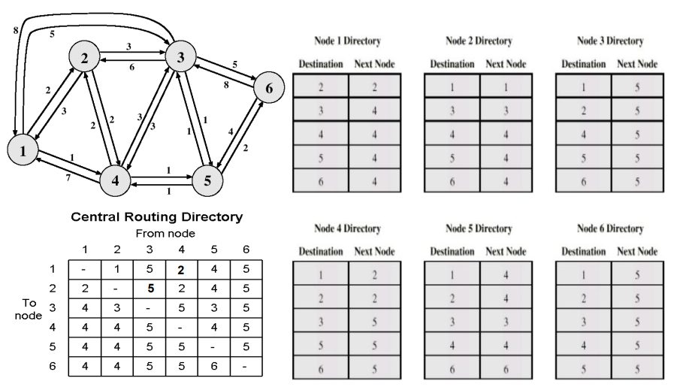
Fixed Routing Tables

Slide 10
Routing Strategies (2)
Flooding
Packet sent by node to every neighbor
No network information required
Eventually multiple copies arrive at destination
Each packet is uniquely numbered so duplicates can be discarded
Need to limit incessant retransmission of packets
Node can remember identity of packet retransmitted

Slide 11
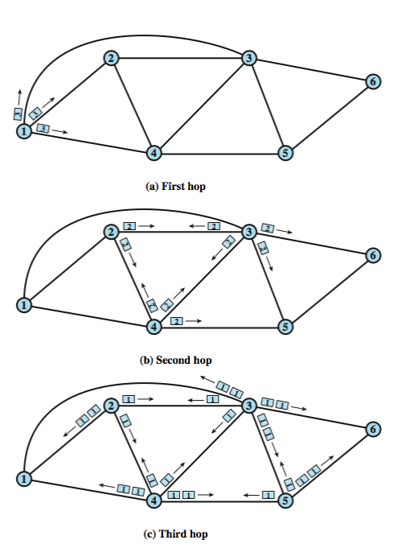
Flooding Example

Slide 12
Properties and Disadvantage
All possible routes are tried
Very robust, military network
At least one packet will have taken minimum hop route
Can be used to set up virtual circuit
Nodes directly or indirectly connected to source are visited
Useful to distribute information
Disadvantage
High traffic load
Security concerns

Slide 13
Routing Strategies (3)
Random routing
Simplicity of flooding with much less traffic load
A route node selects one outgoing path for retransmission of incoming packet
Selection can be random or round robin
A refinement is to select outgoing path based on probability calculation
No network information needed
Random route is typically neither least cost nor minimum hop

Slide 14
Routing Strategies (4)
Adaptive routing
Used by almost all packet switching networks
Routing decisions change as conditions on the network change
Requires information about network
Disadvantages
Decisions more complex
Tradeoff between quality of network info. And overhead
Reacting too quickly can cause oscillation
Reacting too slowly means info may be irrelevant
Advantages
Improved performance
Aid congestion control

Slide 15
ARPANET Routing Evolution (1)
1st generation : distance vector routing (1969)
Distributed adaptive estimated delay, such as queue length
Version of Bellman-Ford algorithm(doesn’t consider line speed)
2nd generation : link state routing (1979)
Distributed adaptive using measured delay, such as RTT
Version of Dijkstra’s algorithm
Re-computed average delays every 10 seconds, and any changes are flooded to all other nodes
Good under light, medium loads, but under heavy loads, little correlation between reported delays and those experienced

Slide 16
ARPANET Routing Evolution (2)
3rd generation : link state routing (1987)
Link cost calculation changed
To damp routing oscillations
To reduce routing overhead
Measure average delay over last 10 seconds and transform into link utilization estimate
Normalize this based on current value and previous results
Set link cost as function of average utilization

Slide 17
Internet Routing Protocols
Routers are responsible for receiving and forwarding packets through the interconnected set of networks Link cost
makes routing decisions based on knowledge of the topology and traffic/delay conditions of the Internet
routers exchange routing information using a special routing protocol
Two concepts in considering the routing function:
routing information
Information about the topology and delays of the Internet
routing algorithm
The algorithm used to make a routing decision for a particular datagram, based on current routing information

Slide 18
Autonomous System (AS)
It exhibits the following characteristics as
it is a set of routers and networks managed by a single organization
consists of a group of routers exchanging information via a common routing protocol
except in times of failure, it is connected (in a graph-theoretic sense); there is a path between any pair of nodes
Interior Router Protocol (IRP)
a shared routing protocol which passes routing information between routers within an AS
custom tailored to specific applications and requirements

Slide 19
Exterior Routing Protocol (ERP)
May be more than one AS in an internetwork
Routing algorithms and tables may differ between different AS
Routers need information about networks outside their AS
Use an exterior router protocol (ERP) for this
Supports summary information on AS reachability
Example
Border gateway protocol (BGP)

Slide 20
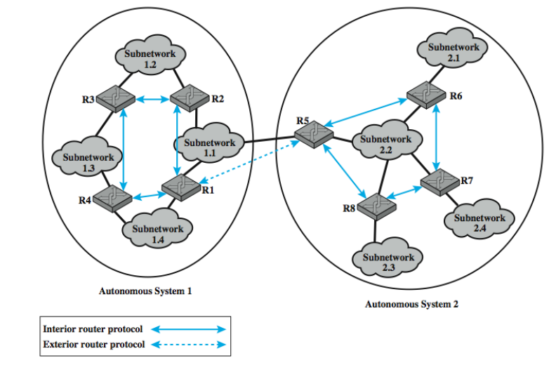
Application of IRP and ERP

Slide 21
Approaches : Distance-vector Routing
Requires that each node (router or host) exchange information with its neighboring nodes
Two nodes are said to be neighbors if they are both directly connected to the same network
First generation routing algorithm for ARPANET
Used by Routing Information Protocol (RIP)
A node maintains a vector of link costs for each directly attached network, distance and next-hop for each destination
Requires transmission of lots of information by each router
Changes take long time to propagate

Slide 22
Approaches : Link-state Routing
Designed to overcome drawbacks of distance-vector
When a router is initialized, it determines the link cost on each of its network interfaces
It then advertises this set of link costs to all other routers in the internet topology, not just neighboring routers
From then on, the router monitors its link costs
Whenever there is a significant change, the router again advertises its set of link costs to all other routers in the configuration
The OSPF protocol is an example

Slide 23
Consideration for ERP
Both are not effective for exterior router protocol
Not distance-vector
Assumes routers share common distance metric
But different Ass may have different priorities & needs
But have no info. On AS that will be visited along a route
Not link-state
Different Ass may use different metrics and have different restrictions
Flooding of link state information to all routers unmanageable

Slide 24
ERP : Path-vector Routing
Alternative to dispense with concept of routing metrics
that is, does not include distance or cost estimate
simply provides information about which networks can be reached by a given router and ASs crossed to get there
so, each block of routing information lists all of the ASs visited in order to reach the destination network by this route
BGP (Border Gateway Protocol)
it was developed for use in conjunction with the TCP/IP suite
it has become the preferred ERP for the Internet
designed to allow routers in different ASs to cooperate in the exchange of routing information
current version is known as BGP-4 (RFC 4271)

